Slide 1
Regularization and the Bias-Variance Tradeoff
METIS

Slide 2
Learning Goals
Understand the bias-variance tradeoff, and its relationship with over/underfitting
Learn how regularization can reduce overfitting by punishing model complexity
Build mathematical intuition for how regularization works

Slide 3
The Bias-Variance Tradeoff
Sources of model error

Slide 4
3 Sources of Model Error
Being wrong
Being unstable
Unavoidable randomness
Bias
Variance
Irreducible Error

Slide 5
3 Sources of Model Error in Detail
Bias
Variance
Irreducible Error
Tendency of predictions to miss true values
Worsened by missing information and simplifying assumptions about feature-target relationships
Miss real patterns (underfit)
Tendency of predictions to fluctuate
Worsened by model’s sensitivity to small changes in training data, often due to overly complex models
Overfit to noise patterns
Intrinsic uncertainty/randomness
Present in even the best possible model
Tendency = expectation of out-of-sample behavior over many training set samples

Slide 6
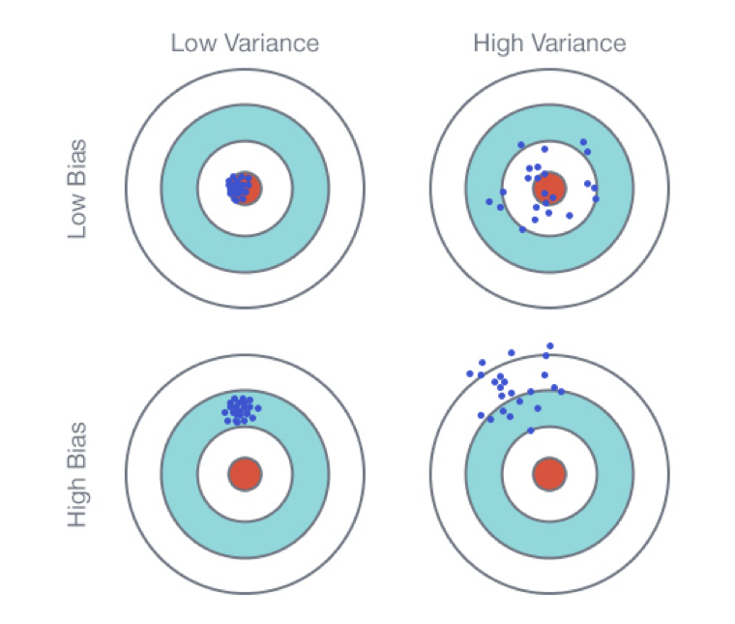
Bias & Variance Intuition
Bias & variance – at an intuitive level
Note: this visual is for intuition building and shouldn’t be interpreted literally!
Roughly, bias is tendency to miss, while variance is tendency to be inconsistent
Ideally we get the top left outcome: highly consistent predictions that are close to perfect on average

Slide 7
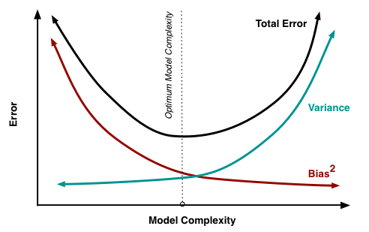
Bias-Variance Tradeoff, Visualized
Visualizing the complexity tradeoff
Usually we analogize the bias-variance tradeoff to a complexity tradeoff
Model adjustments that decrease bias often increase variance, and vice versa
Finding an optimally predictive model is essentially an exercise in finding the right balance of complexity
We search for a model that is elaborate enough to describe the feature-target relationship (not underfit), but not so elaborate that it fits to spurious patterns in the training data (not overfit)

Slide 8
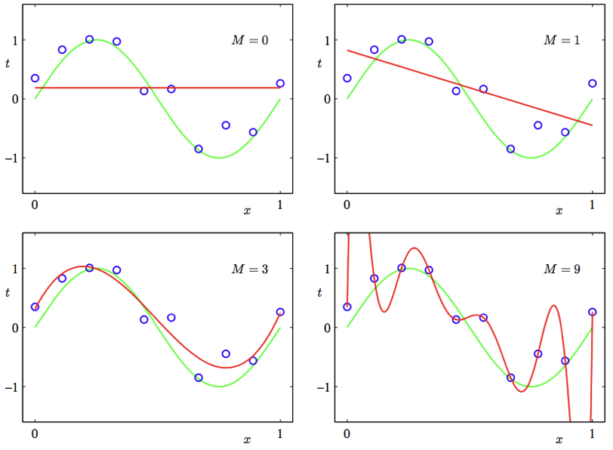
Bias-Variance Tradeoff: Example
Complexity tradeoff: polynomial regression
The higher the degree of a polynomial regression, the more complex the model (lower bias, higher variance)
At degrees 0 and 1, we can see visual signs of bias: the predictions are too rigid to capture the curve pattern in the data
At degree 9, we can see visual signs of variance: the predictions fluctuate wildly because of the model’s sensitivity
Degree 3 is just right: the model has sufficient complexity to describe the data without overfitting to noise

Slide 9
Regularization
Reducing Overfitting By Punishing Model Complexity

Slide 10
Can we tune with more granularity than choosing polynomial degrees?
Yes! By using regularization

Slide 11
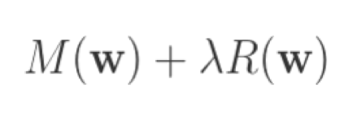
What Does Regularization Accomplish?
New cost function
M(w): model error
R(w): complexity cost
Lambda: adjustable weight of complexity cost
Regularization adds a term that penalizes model complexity directly into the cost function
A regularization strength parameter lambda controls the tradeoff in priorities: minimizing fit error and minimizing complexity
Lambda then allows us to continuously adjust the complexity tradeoff: more regularization introduces a simpler model / more bias, while less regularization makes the model more complex and increases variance
If our model is overfit (variance too high), regularization can often improve generalization error by reducing variance

Slide 12
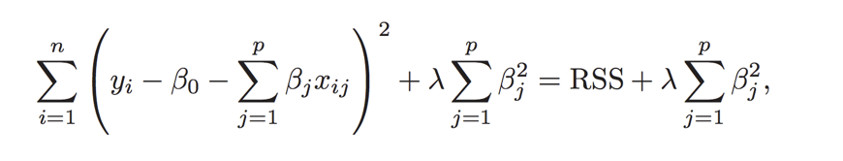
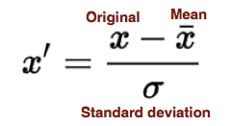
Reg Cost Function: Ridge Regression
Fit model by minimizing:
In ridge regression, the complexity penalty is the sum of the squared coefficient values
The penalty term has the impact of “shrinking” the coefficients toward 0. This constraint imposes bias on the model, but also reduces its variance
We should always select the correct regularization strength lambda via validation / cross-validation
It’s best practice to standard scale the features so that you aren’t applying unfair penalties based on the original feature scales
Warning: scale matters!

Slide 13
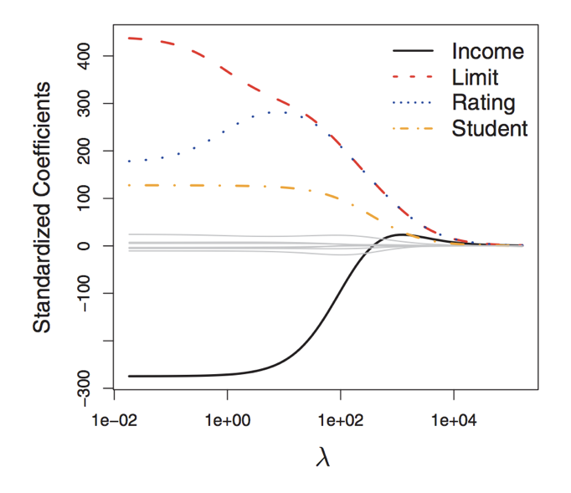
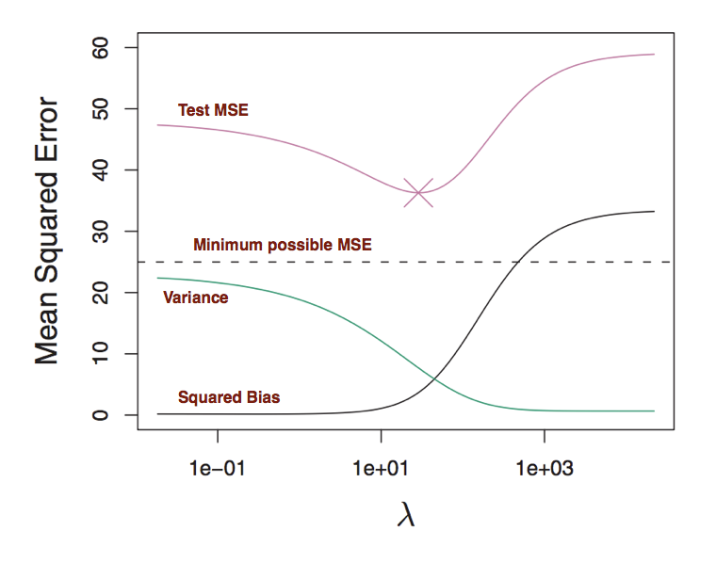
Ridge Regression in Action
Complexity tradeoff: variance reduction may outpace increase in bias, leading to a better model fit!
Shrinkage effect as regularization strength increases

Slide 14
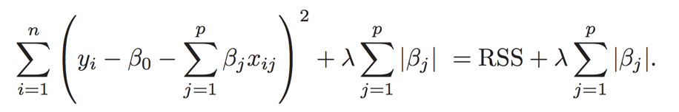
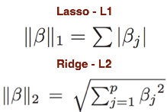
Alternative: LASSO Regression
Fit model by minimizing:
In LASSO regression, the complexity penalty is the sum of the absolute value of the coefficients
The SS stands for “shrinkage” and “selection”, and the A stands for “absolute” (Least Absolute Shrinkage and Selection Operator)
Similar effect to ridge in terms of complexity tradeoff – increasing lambda raises bias but lowers variance
Unlike ridge, LASSO performs feature selection, in that as lambda increases coefficients start to be zeroed out
Math aside: penalties are equivalent to L1/L2 norms

Slide 15
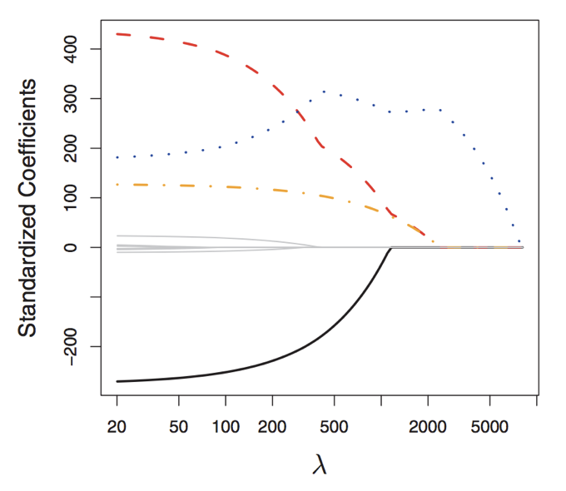
LASSO Regression in Action
Shrinkage and selection effect as regularization strength increases: some features drop to 0
Complexity tradeoff: variance reduction may outpace increase in bias, leading to a better model fit!

Slide 16
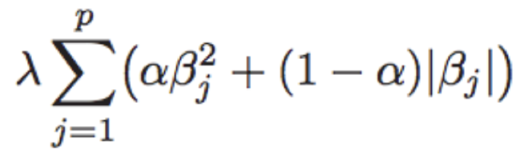
Ridge vs. LASSO?
Luckily, validation/cross-validation gives us an empirical method for selecting between different models. Everything depends on the data, we should always validate!
LASSO’s feature selection property yields an interpretability bonus, but may underperform if the target truly depends on many of the features
We can also try a hybrid approach, elastic net, which introduces a new parameter alpha that balances a tradeoff between L1 and L2 penalties
Hybrid approach: elastic net

Slide 17
Regularization: Digging Into the Math
Why Does it really work?

Slide 18
The Analytic View
Increasing L2/L1 penalties force coefficients to be smaller, restricting their plausible range. A smaller range for coefficients must be simpler/lower variance than a model with an infinite possible coefficient range.
Ridge
LASSO

Slide 19
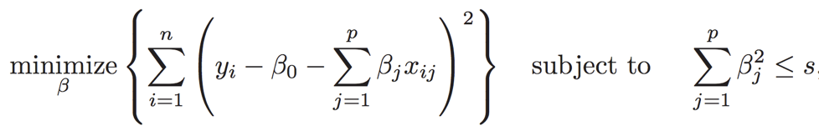
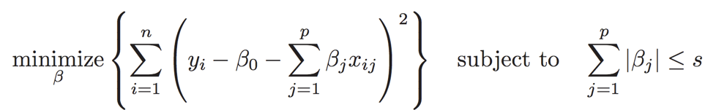
The Geometric View
Below are mathematically equivalent formulations of the optimization objectives of ridge/LASSO
Ridge
LASSO

Slide 20
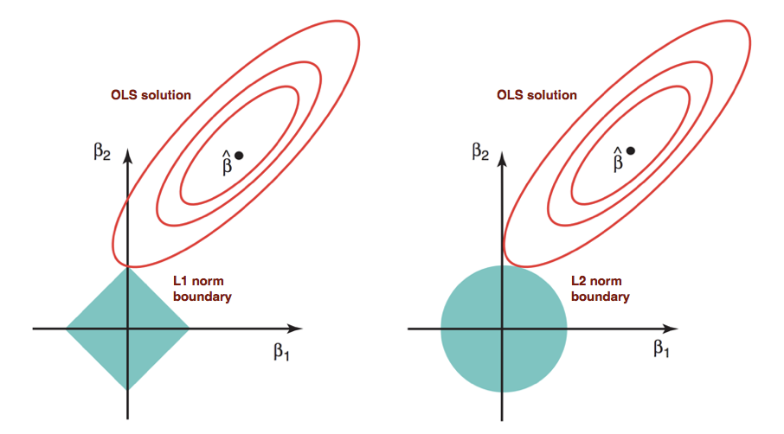
The Geometric View Cont.
Under this geometric formulation, the cost function minimum is found at the intersection of the penalty boundary and a contour of the traditional OLS cost function surface. The geometry reveals the selection effect of LASSO (intersection at a corner/axis zeroes out coefficients)
LASSO
Ridge

Slide 21

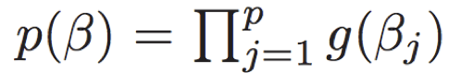
The Probabilistic View
Bayes!: Regularization imposes certain priors on the regression coefficients
Letting f be the likelihood (probability of target given parameter vector beta) and p(beta) be the prior distribution of beta, we can calculate the posterior of beta
p(beta) is derived from independent draws of a prior coefficient density function g that we choose when regularizing
L2 (ridge) regularization imposes a normal prior on the coefficients, while L1 (lasso) regularization imposes a Laplacian prior on the coefficients

Slide 22
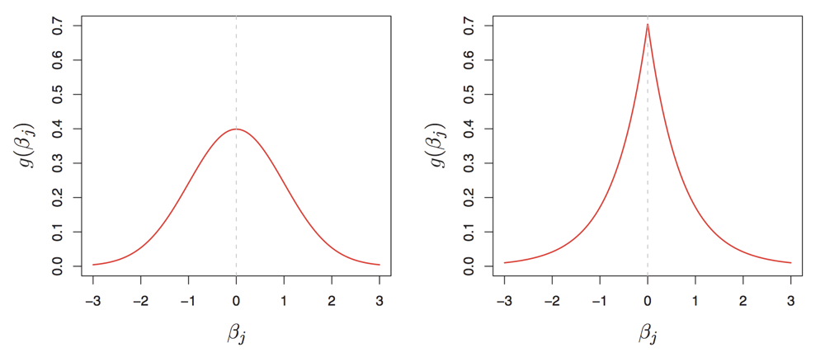
The Probabilistic View Cont.
Visualizing these prior distributions again reveals the difference in behavior between ridge and LASSO: the Laplacian distribution has peaked density at 0, explaining its tendency to zero out some coefficients
Ridge: gaussian prior
LASSO: Laplacian prior

Slide 23
Lesson Recap
Complexity Tradeoff
Regularization
How it Works
Optimizing predictive models is all about finding the right bias/variance tradeoff
We need models that are sufficiently complex to capture patterns in data, but not so complex that they overfit to noise
Reduce complexity by penalizing it in cost function
Increases bias, but reduces variance – may be worth the trade
Options: L2, L1, Can validate the choice and strength
Analytically: penalty constrains the coefficient range
Geometrically: L1/L2 imposes bounded regions
Probabilistically: imposes prior on coefficients

Slide 24
Thank You!

Slide 25
Image Citations
Slides 6-7: Scott Fortmann-Roe
Slide 8: Justin Domke
Slides 11-16; 18-22: Introduction to Statistical Learning with Applications in R

